Slide 1
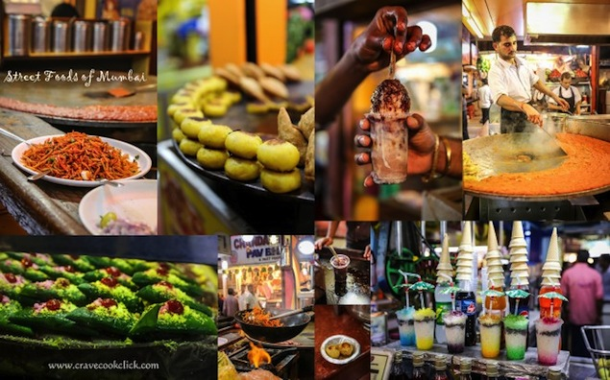
Analysing Restaurants in Mumbai for food supply during Covid-19 Lockdown

Slide 2

INTRODUCTION
Mumbai, “The City of Dreams” as they say, is indeed one of the most magnificently alluring and beautiful cities of all times.
The world is fighting against a huge virus that has affected the whole world as a whole: COVID-19 or the dreaded "Corona Virus".
In this project, we will be exploring the restaurants around Mumbai city and analyse the cuisine served, delivery options and ratings of the restaurants in Mumbai, one of the prime locations in India.
This will talk about the vast array of options and how they operate in these times, marking best neghbourhoods in terms of good rating restaurants.

Slide 3
DATA DESCRIPTION
Restaurant data in Mumbai filtering on ratings, location and delivery options
SOURCE LINK: Zomato Kaggle Data
DATA STORAGE: Every Restaurant contains the following variables • Restaurant Id: Unique id of every restaurant across various cities of the world • Restaurant Name: Name of the restaurant • Country Code: Country in which restaurant is located • City: City in which restaurant is located • Address: Address of the restaurant • Locality: Location in the city • Locality Verbose: Detailed description of the locality • Longitude: Longitude coordinate of the restaurant's location • Latitude: Latitude coordinate of the restaurant's location • Cuisines: Cuisines offered by the restaurant • Average Cost for two: Cost for two people in different currencies • Currency: Currency of the country • Has Table booking: yes/no • Has Online delivery: yes/ no • Is delivering: yes/ no • Switch to order menu: yes/no • Price range: range of price of food • Aggregate Rating: Average rating out of 5 • Rating color: depending upon the average rating color • Rating text: text on the basis of rating of rating • Votes: Number of ratings casted by people
LOCATION DATA SOURCE: Foursquare API

Slide 4
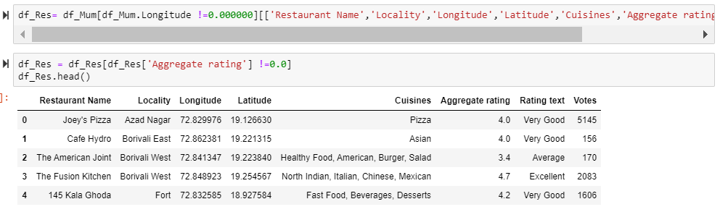
PREPROCESSING
The cleaning is done by eliminating unnecessary attributes and formatting the numerical data in a specific format as can be viewed in latitude and longitude values along with Aggregate Ratings.

Slide 5
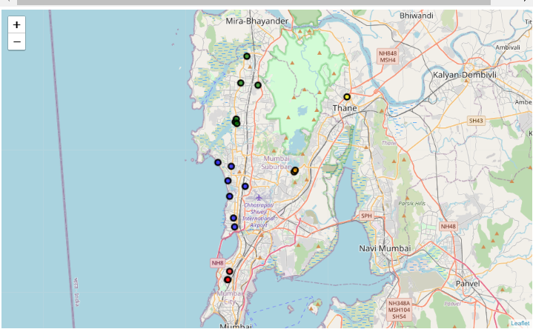
EXPLORATORY DATA ANALYSIS
Initially we will be viewing the clusters in Mumbai based on location of the restaurants.

Slide 6
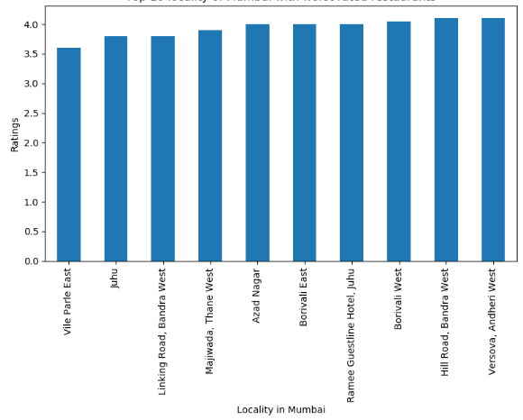
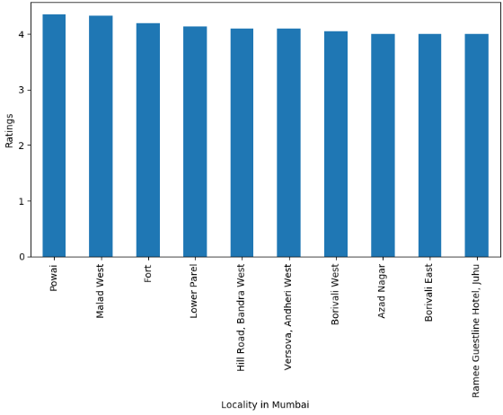
EXPLORATORY DATA ANALYSIS
Top 10 locality of Mumbai having highest rated restaurants
Top 10 locality of Mumbai with worst rated restaurants

Slide 7
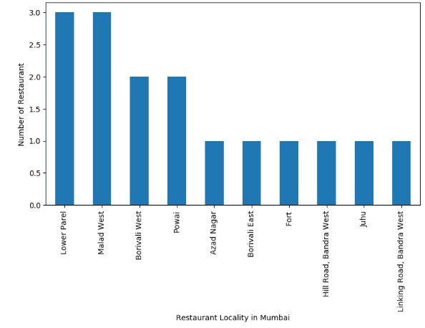
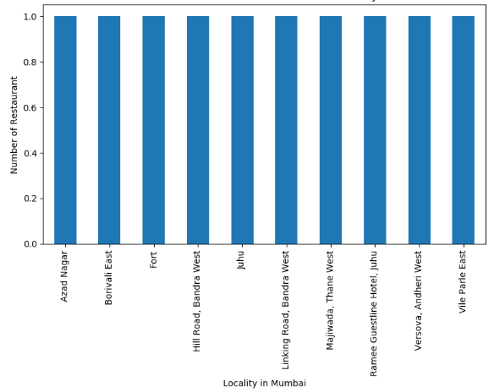
EXPLORATORY DATA ANALYSIS
Lowest number of Restaurant available in Locality of Mumbai
Highest number of Restaurant available in Locality of Mumbai

Slide 8
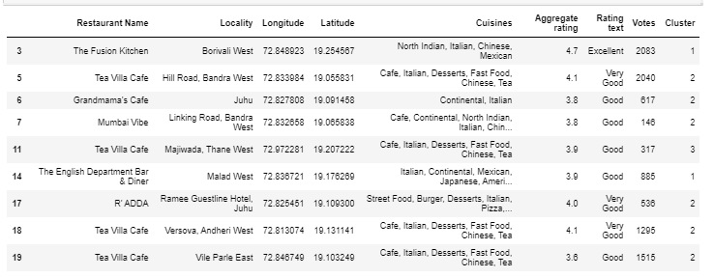
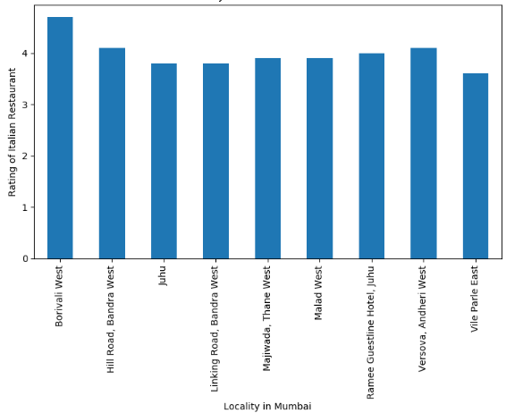
EXPLORATORY DATA ANALYSIS
The Cuisine that is most prevalent in a lot of areas in Mumbai is "Italian". Finding best places for getting Italian cuisines with grouping based on locality.
"Borivali West" has the best rated Italian restaurant in Mumbai named "The Fusion Kitchen"

Slide 9
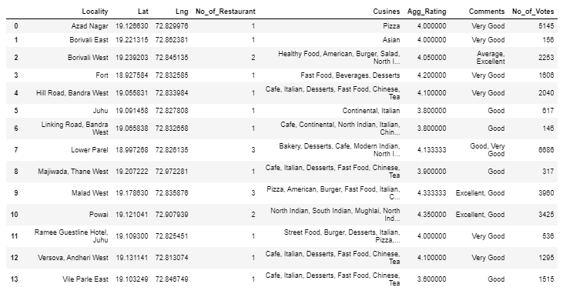
DATA TRANSFORMATION
Grouping was performed, the values were cleaned and only the attributes that are necessary for performing operation was obtained. This can be viewed as a grouped list of location areas as shown below appended by their latitude and longitude configuration to obtain specific location.

Slide 10
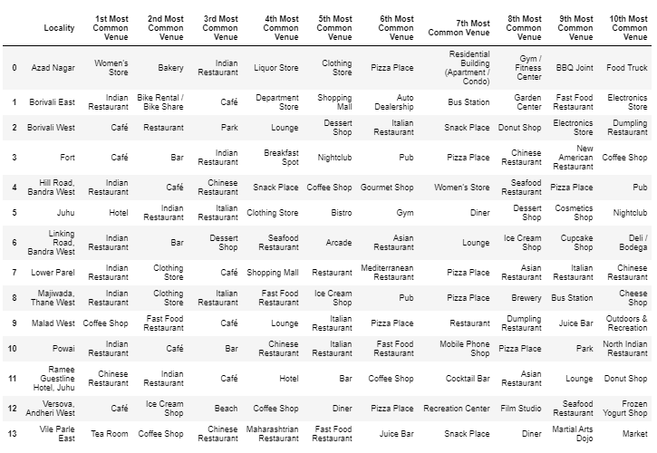
DATA TRANSFORMATION
The areas were analyzed using Foursquare API to obtain the categories of venues available in each region. In this process we obtained 113 unique categories.

Slide 11
CLUSTERING
Clustering is the task of dividing the population or data points into a number of groups such that data points in the same groups are more similar to other data points in the same group and dissimilar to the data points in other groups.
KMEANS ALGORITHM is an iterative algorithm that tries to partition the dataset into Kpre-defined distinct non-overlapping subgroups (clusters) where each data point belongs to only one group. It tries to make the intra-cluster data points as similar as possible while also keeping the clusters as different (far) as possible. It assigns data points to a cluster such that the sum of the squared distance between the data points and the cluster’s centroid (arithmetic mean of all the data points that belong to that cluster) is at the minimum. The less variation we have within clusters, the more homogeneous (similar) the data points are within the same cluster.

Slide 12
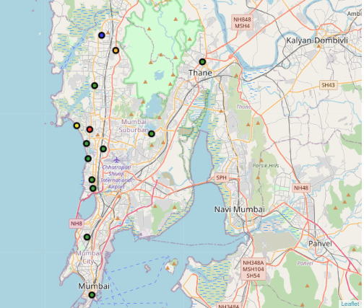
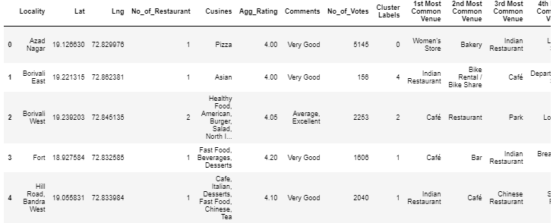
CLUSTERING
K-Means was applied to obtain locations in 5 clusters. This can be viewed as:

Slide 13
RESULTS
The performed clustering led to the creation of following 5 clusters based on similarity along with their associated latitude longitude value determining location. This can be seen in the above map
Cluster 1 marked in Blue, is best suited for Indian restaurants
Cluster 2 marked in Orange, is best suited for Tea rooms
Cluster 3 marked in Green, is best suited for Cafes
Cluster 4 marked in Red, is best suited for Cafes
Cluster 5 marked in Yellow, is best suited for Chinese restaurants

Slide 14
DISCUSSIONS
Considering the times of harmful virus taking over the world, the Zomato ensures restaurant listing on its API is of the highest hygiene standard as issued by the WHO.
This is being checked upon on the following factors:
•Sanitized kitchen as per WHO advisory
•Daily Temperature checks
•Provide hand wash stations for riders
•Grading sanitation levels as Poor, Good and Excellent
Keeping this in mind and viewing the feature of online delivery and availability, the data clearly shows what all restaurants are available in a given localition Mumbai and what is the type of cuisine being served by them. this, thus allows a comprehensive check on food availability for all the people even during lockdown based on their respective cuisine filtration.

Slide 15
CONCLUSION
This project evaluates the restaurant availability in Mumbai. As can be seen, the culture of Cafes is pretty evident in most regions of the city. This analysis of cuisine availability based on location helps a viewer filter data and find desired cuisine food in their own locality. This will ensure the safety of users and provide delivery. This project can be extended to include the large frontline warriors including the doctors, police officers, etc. to be provided food by home cooks and ensure no one sleeps hungry in this fast-paced city thus helping fight this virus standing united as one.

Slide 16


THANK YOU

